Slide 1
Finding trends in insulin acquisition costs.
Clayton Summitt

Slide 2
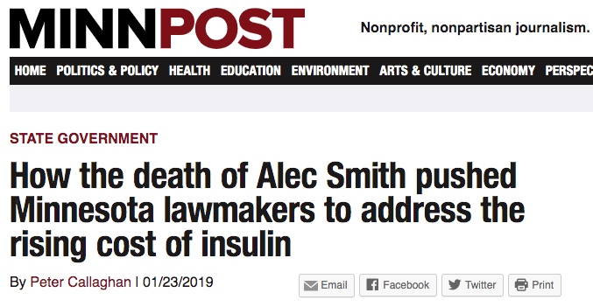


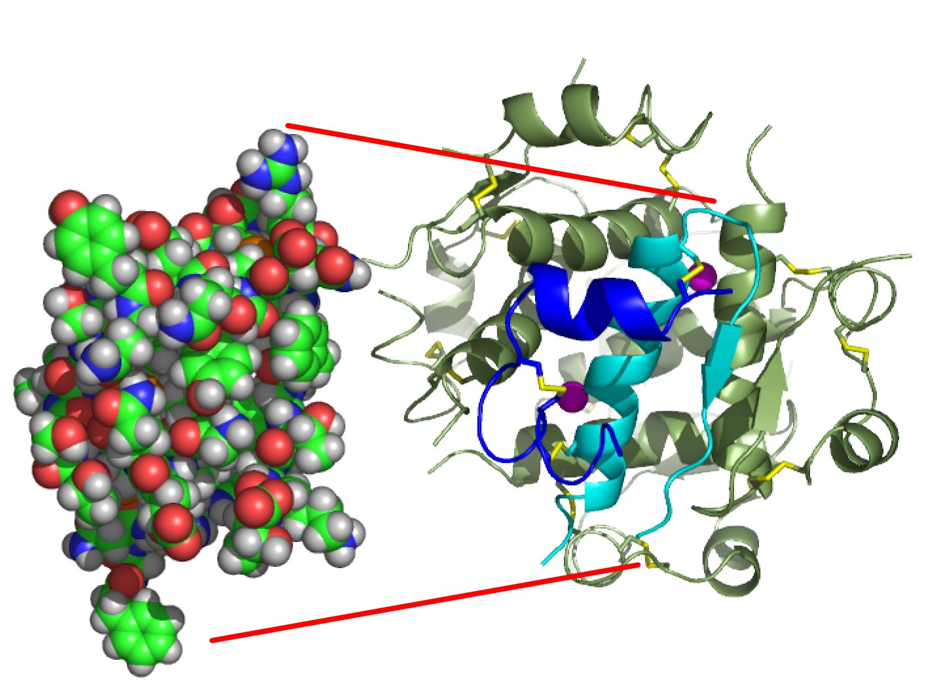
Motivation

Slide 3
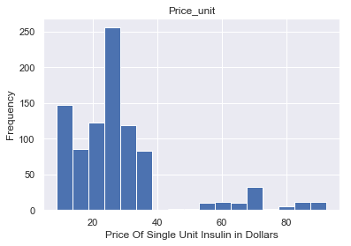
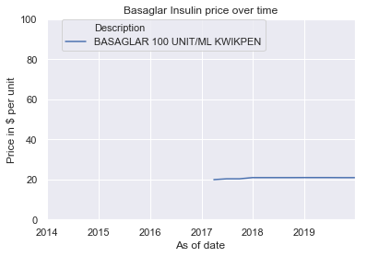
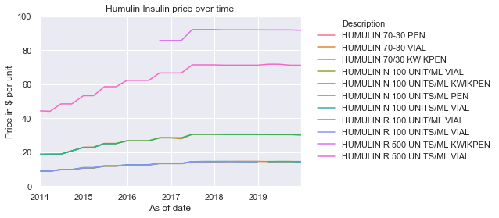
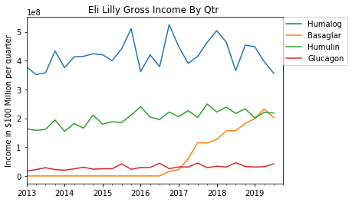
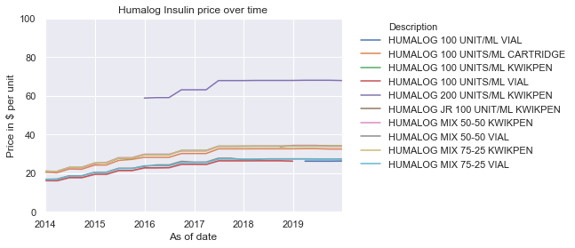

Slide 4
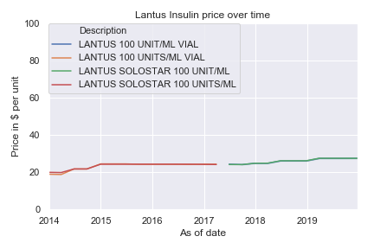
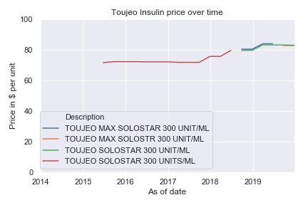
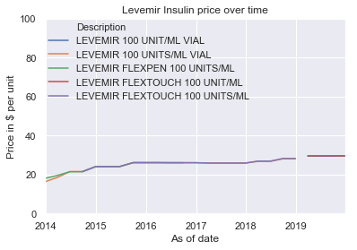
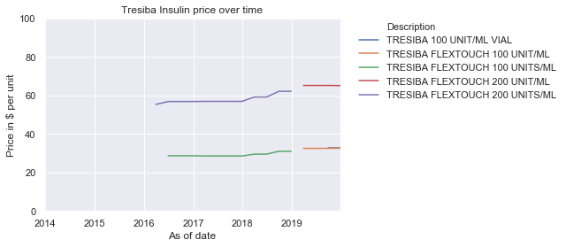
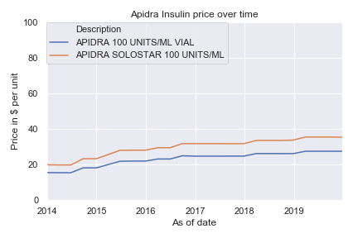
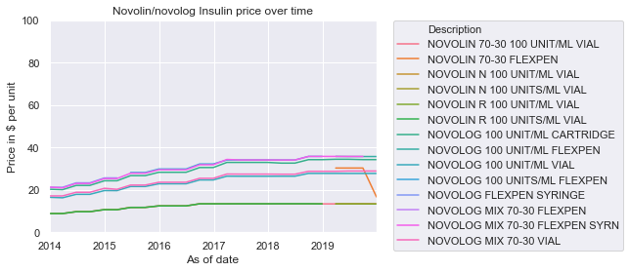

Slide 5
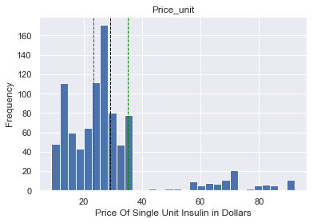
Hypothesis testing
H₀ : There is no difference in mean price between Human and Analogue Insulin.
H_{a}: There is a difference in mean price between Human and Analogue insulin.
Two way t-test : P value = 6.68* 10⁻⁷
We lack sufficient evidence to reject the null
H₀ : There is no difference in mean price between Long and Fast acting Analogue Insulin.
H_{a}: There is a difference in mean price between Long and Fast acting Analogue Insulin.
Two way t-test: P value = 2.215* 10⁻⁷
We lack sufficient evidence to reject the null

Slide 6
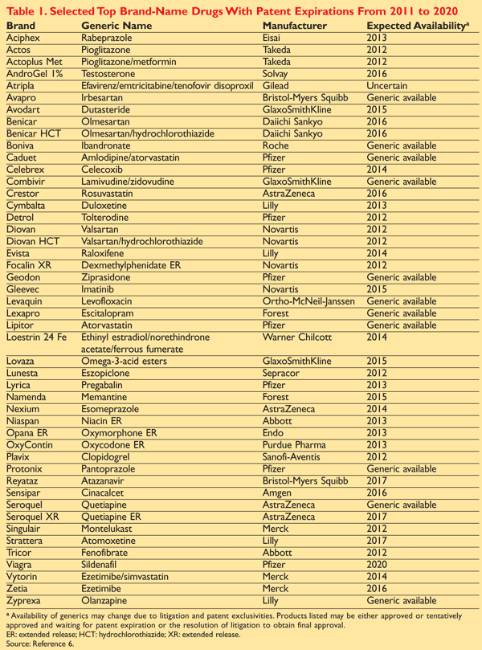
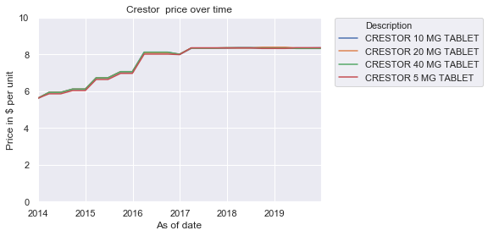
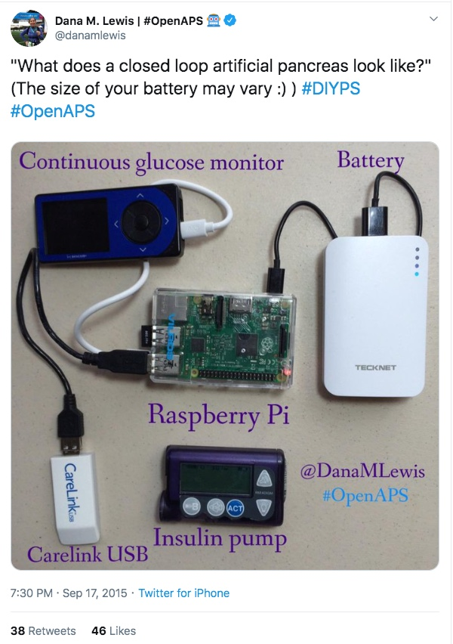

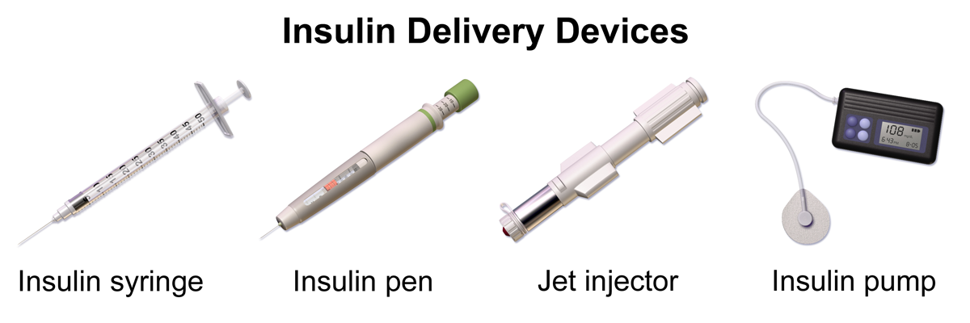
Conclusions:
Excel files are messy.
Duplicate data is real and hard to find
Humans are inconsistent?
Generic effects on price, income?
Twitter?

